Slide 1
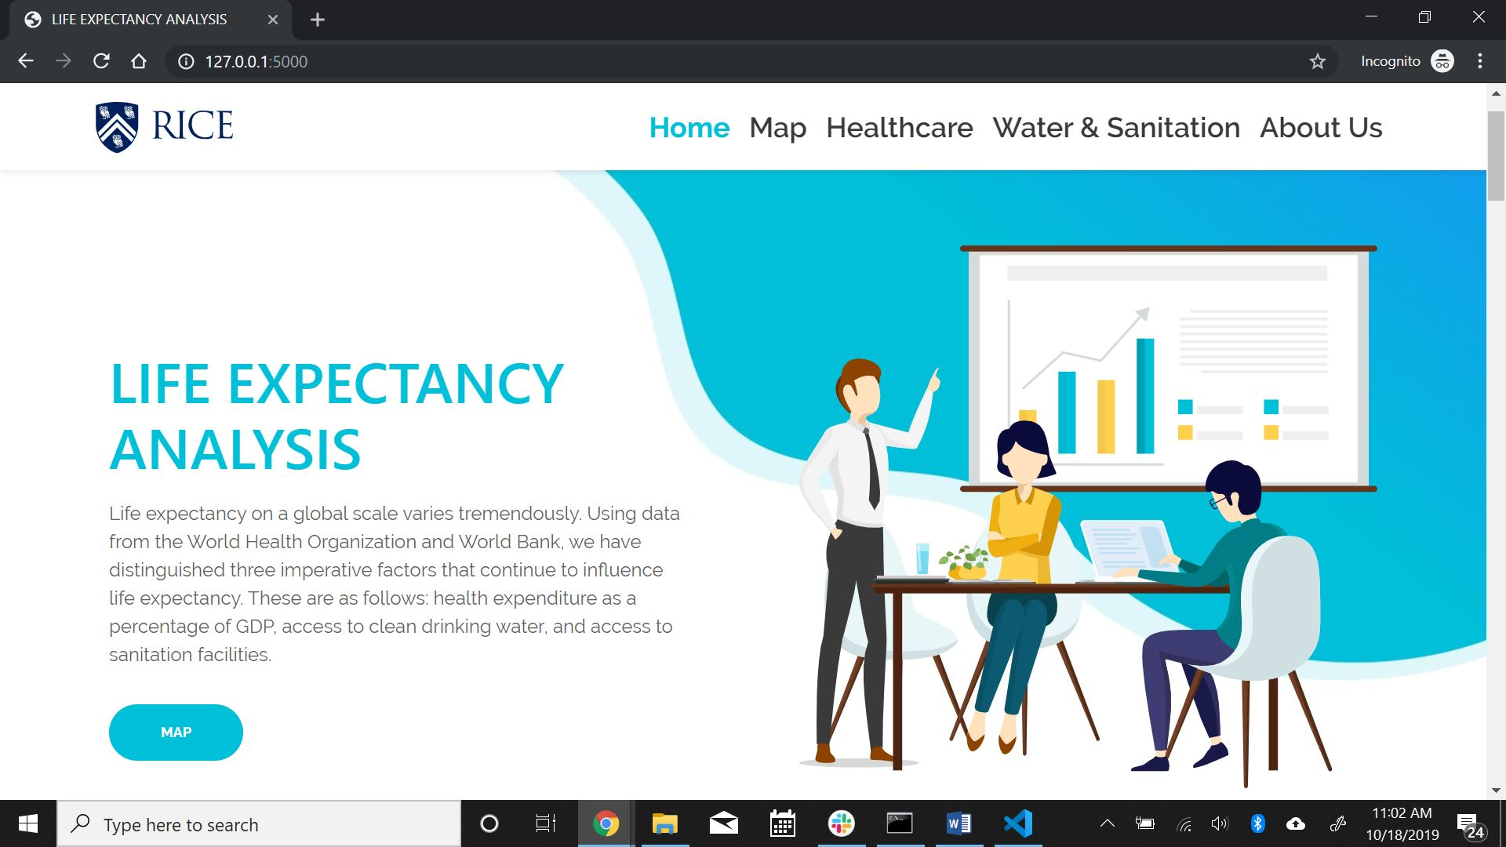
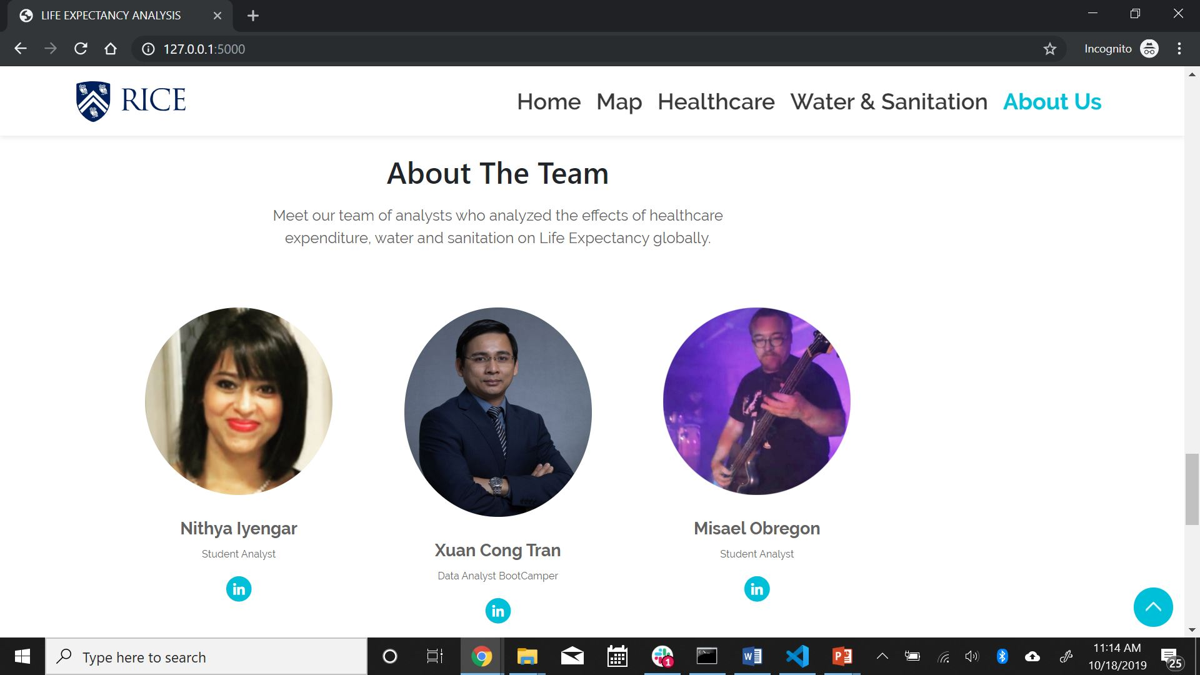
LIFE EXPECTANCY ANALYSIS

Slide 2
WHY WE CHOSE THIS TOPIC?
Life expectancy on global scale varies tremendously.
Using data from the World Health Organization, World Bank and Datahub.io, we have distinguished three imperative factors that continue to influence life expectancy.
These are as follows:
Health expenditure as a percentage of GDP
Access to clean drinking water
Sanitation facilities

Slide 3
MAKING IT INTERACTIVE

Slide 4
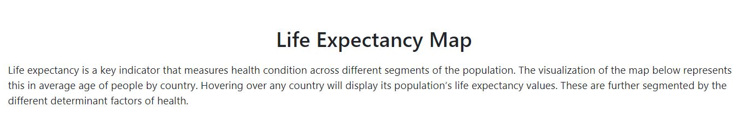
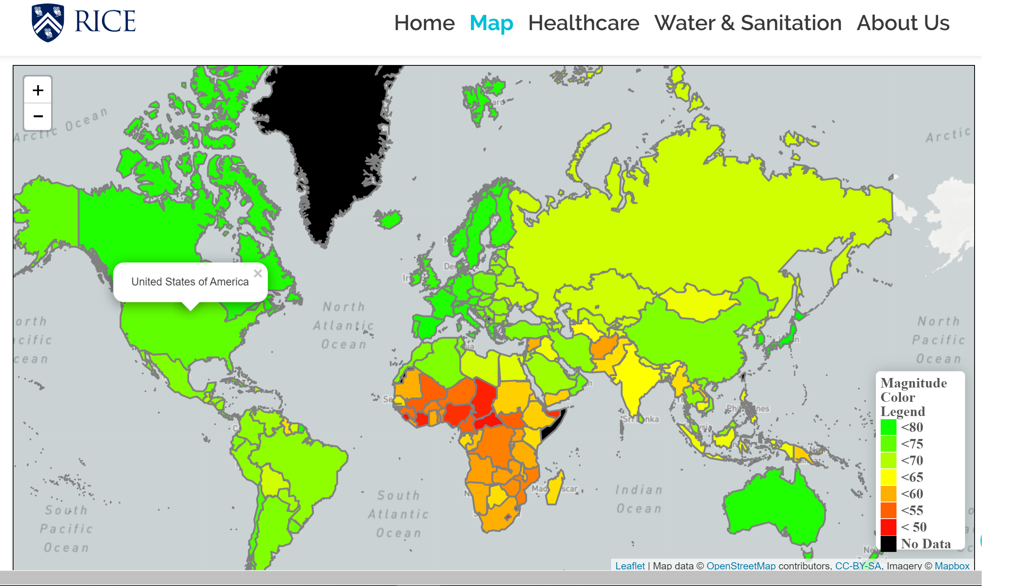

Slide 5
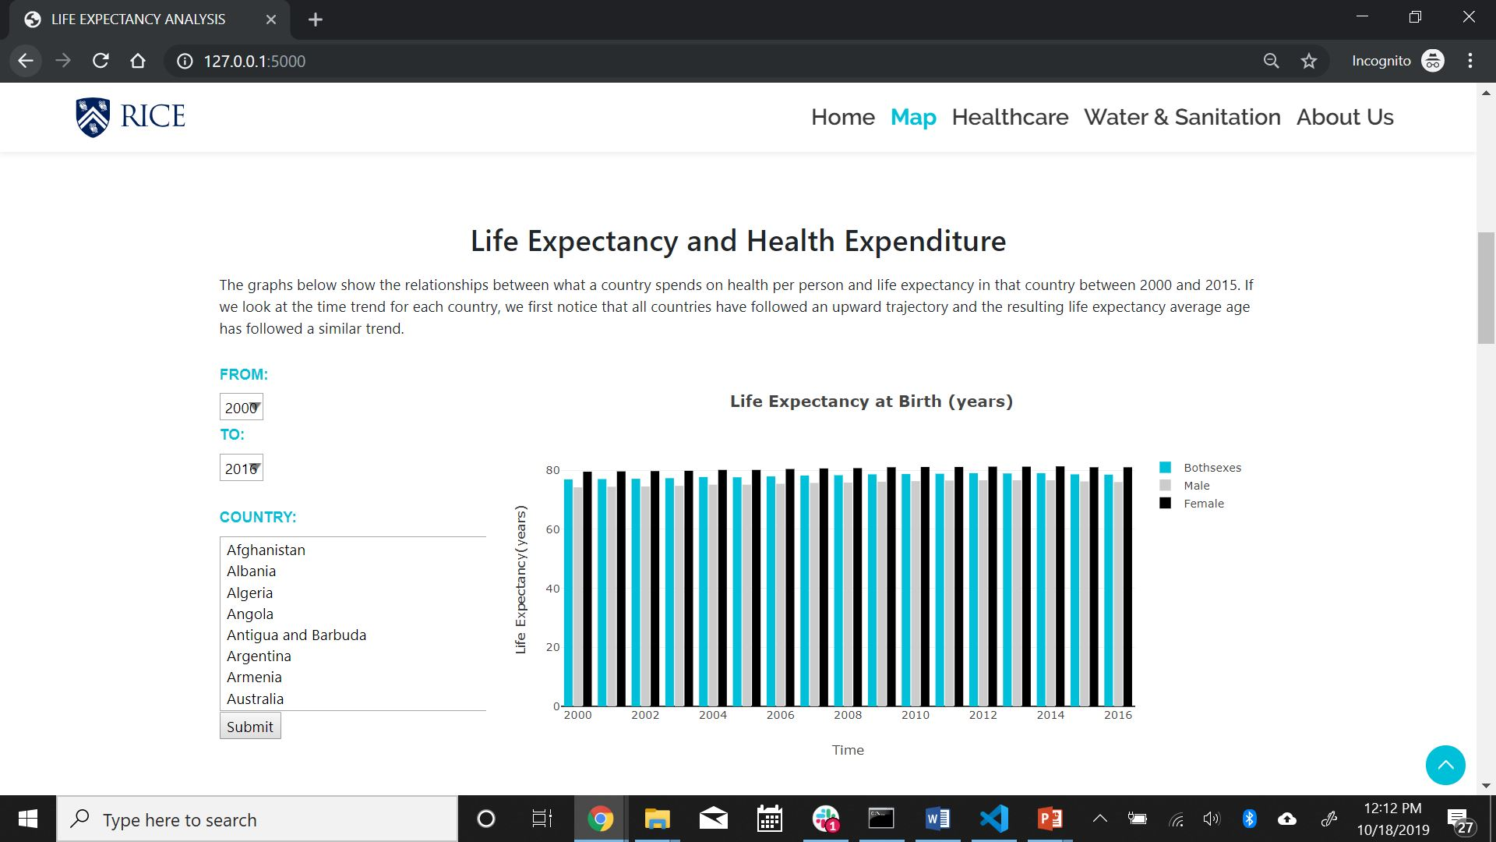

Slide 6
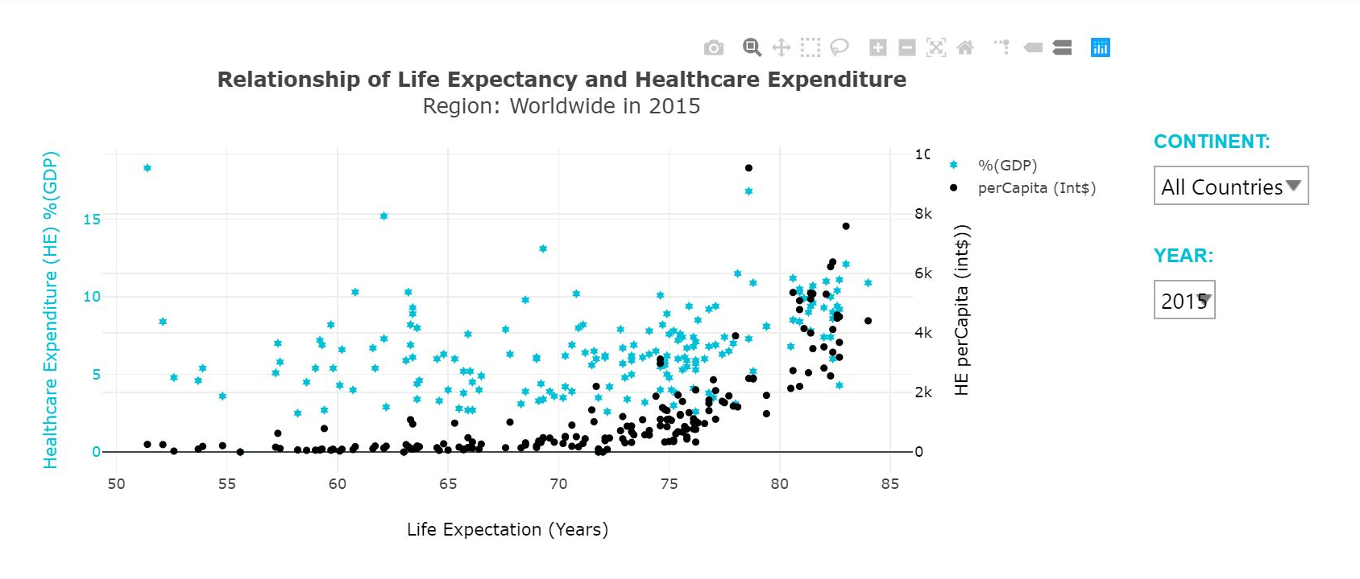

Slide 7
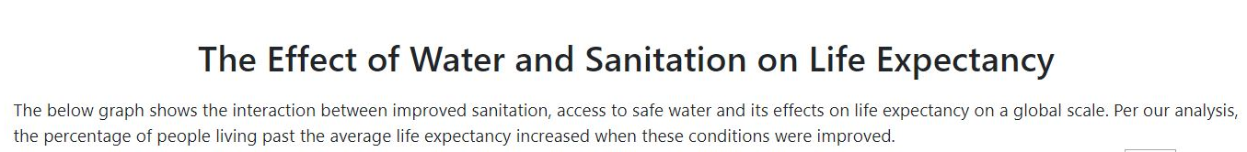
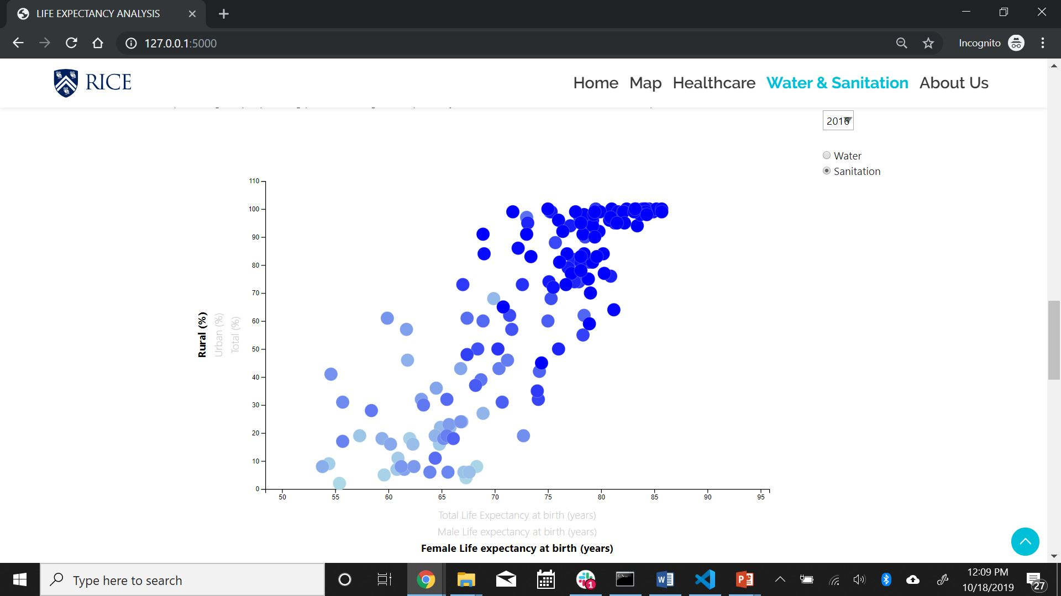

Slide 8
CONCLUSION
The results of this analysis tell us that water and improved sanitation hold greater weight than health expenditure when looking at life expectancy rates on a global scale. More specifically, access to improved sanitation is the stronger factor when it comes to examining life expectancy, while access to improved water conditions comes close second.

Slide 9
TECHNICAL ASPECTS
Data Source: World Health Organization World Bank Datahub.io
Data Cleaning Process: Data in XLS or CSV format. We used Excel to do a minor cleanup. Added ‘0s’ to null values. Data in GeoJSON for mapping purpose. Build flask to feed data in Json format.
How are things connected: We deployed using flask, local machine:5000 Using D3 to read data from csv and json files. Using Plotly, Leaflet and D3 to build charts. Deployed HTML to Heroku application.
How we serve the data: We transferred the data from csv format to db format. Applied SQLAlchemy to connect db with python. We used the connection in the flask to serve data in Json format.
Data Files (.json, .csv, .db)
Flask(/), SQLAlchemy, SQLite
Libraries: Javascript, D3, jQuery
HTML Template, CSS, Bootstrap
Leaflet, Plotly
Heroku Application, Github

Slide 10
ANY QUESTIONS?
THANK YOU

